Slide 1


MORE EFFICIENT USE OF PUBLIC LIGHTING WITH DATA ANALYTICS BASED ON MACHINE LEARNING
Makbule Ozge Ozler, Merve Bekler, Dr. Huseyin Budak, Dr. M. Ozgur Gungor

Slide 2
Table of Content
Introduction
Literature Review
Statement of Problem
Methodology
Findings and Analysis
Conclusion
References

Slide 3
Introduction
Streetlights are not lambs that enlighten their ambiance; they are more than a lamb on the road.
An adequately designed street lighting system is crucial (Leccese et al., 2020). The number of streetlights in a city generally depends on the city’s surface or demography.
A flawed designed lighting system can contribute to light pollution.
In all cases, their number consists of great expense for the government.
Therefore, governments should take precautions related to useless energy utilization and detect abnormal energy usage.
Before taking precautions and detecting abnormal utilization, the pattern of regular electricity consumption should be obtained.

Slide 4
Literature Review
Leccese et al. (2020) studied the applicability of the space syntax methodology to determine street lighting classes.
Serrano-Guerrero et al. (2020) suggested a new time-series treatment method: seasonality analysis of electricity consumption (SAEC) since several other methods do not produce the expected results.
Chen and Wu (2018) considered that although data mining techniques are developed and datasets are emerging, no reliable regional-scale empirical models use real data. Therefore, they attempted to identify the concealed distribution patterns in regional energy consumption.

Slide 5
Statement of Problem
The case from Turkey on energy consumption analysis of region-based street lighting has been studied to determine possible anomalies on monthly-based net consumption values in meters.
Within the scope of this study, 38 thousand meters of 21 different private Electricity distribution companies in 71 different provinces were analyzed. The monthly data of these meters for the last two years (2019/01 - 2021/01) were collected.

Slide 6
Methodology
This problem is handled as anomaly detection in time series.
The FbProphet library developed by the Facebook team was used to solve the problem.
In the study, net consumption values were forecasted for each month using FbProphet. Confidence intervals were determined using the lower and upper limits of the forecasted value obtained. Values outside this confidence interval were defined as anomalies.

Slide 7
Methodology (cont’d)
Apache Spark was used to analyze the counters simultaneously in the analysis process.
This study of models also delivered a set of forecasts the monthly consumptions of each electricity meter within a confidence interval. Consumptions outside this confidence interval are defined and accepted as anomalies.

Slide 8
Methodology (cont’d)
In order to measure the success of the established models, MAPE (Mean Absolute Percent Error), which is one of the error metrics frequently used in the literature, was used.

Slide 9
Findings&Analysis-1
On an annual basis, we see that consumption decreases in summer months due to the variation of sunshine duration according to months, while consumption increases in the winter months.
This shows us that there is seasonality in the data.

Slide 10
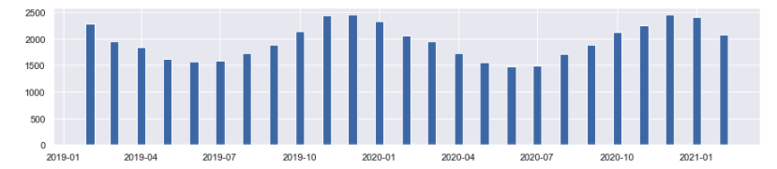
Findings&Analysis-1 (cont’d)
The following graph is obtained when the data is visualized to prove this. This graph gives us the average change in net energy consumptions within the relevant months. While a decrease is observed in consumption in June, July, and August, it is seen that there is an increase in December, January, and February.
Figure 1. Average Change of Net Energy Consumption in Relevant Month/Year

Slide 11
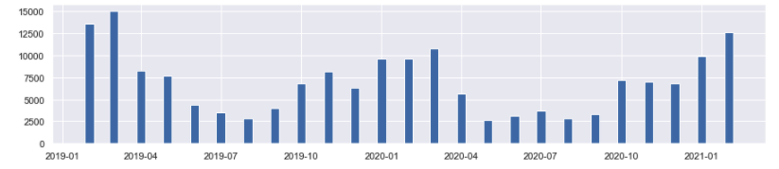
Findings &Analysis-2
The graph below gives us the distribution of found anomalies in the months and years analyzed.
While net consumption measurements with fewer anomalies were found in summer months, net consumption measurements with more anomalies were observed in winter months.
In parallel to the trend of net consumption, there is also seasonality in the observations with anomalies.
Figure 2. Distribution of Anomaly Numbers by Month/Year

Slide 12
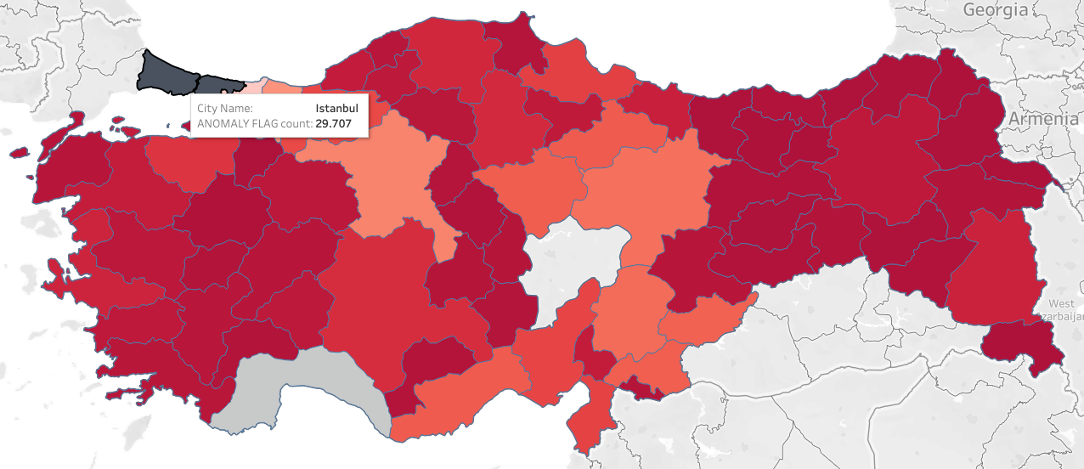
Findings &Analysis-3
When we examine the net consumption values with anomalies in Turkey, the first place is in the province of Istanbul. Antalya follows it.
The graph in Figure 3 shows the number of anomalies as the color intensity increases. In other words, the darkest provinces contain the most anomalies. Provinces not included in the analysis are depicted in gray.
Figure 3. Distribution of the Number of Net Consumption Measurements Containing an Anomaly Based on Provinces in Turkey

Slide 13
Conclusion
General lightings such as streetlights, road, and building lightings significantly affect regions’ economies.
One can find varied papers using varied methods to analyze and from varied perspectives from different countries.
Our statement problem included obtaining a well-cleaned dataset and utilizing this dataset to detect anomalies with time series analysis.
The results concluded an accord with the net electricity consumption distribution, and the distribution of the sum of anomaly consumptions was observed.

Slide 14
References

Slide 15
Thank you for your attention
Questions?
Email:
ozge.ozler@gtech.com.tr

